Slide 1
Machine Learning
Pallika Kanani

Slide 2
Robots: Fiction

Slide 3
Robots: Fact

Slide 4
Robots: Fact
PEPPER
KURI
ROOMBA
ATLAS

Slide 5
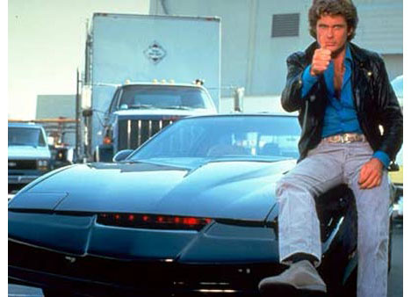
Self-Driving Cars: Fiction

Slide 6
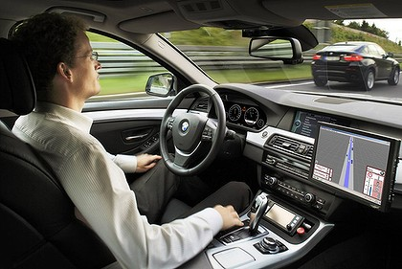
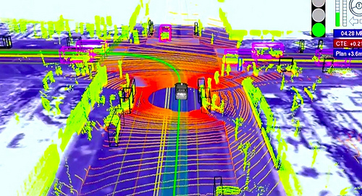
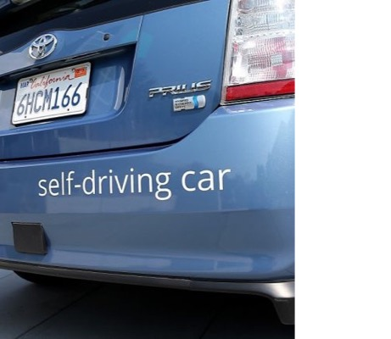
Self-Driving Cars: Fact

Slide 7
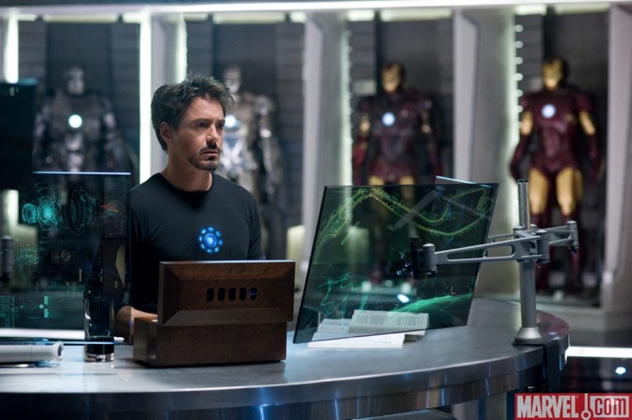
Natural Language Processing: Fiction

Slide 8
Natural Language Processing: Fact

Slide 9
A.I. is All Around You

Slide 10
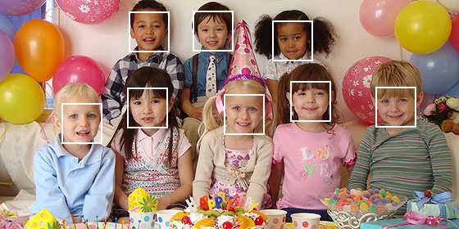
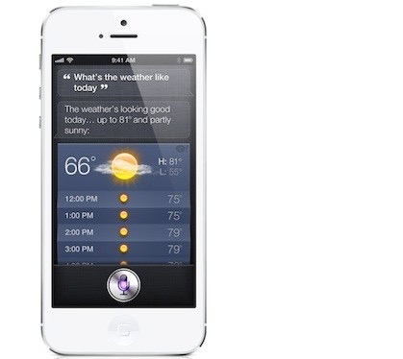
Helping With Small Everyday Tasks

Slide 11
Helping You Find Information and Connect with People

Slide 12
Recommending Things to Buy

Slide 13
Recommending Music and Movies Based on Your Taste

Slide 14
Even Making Important Decisions about Your Life

Slide 15
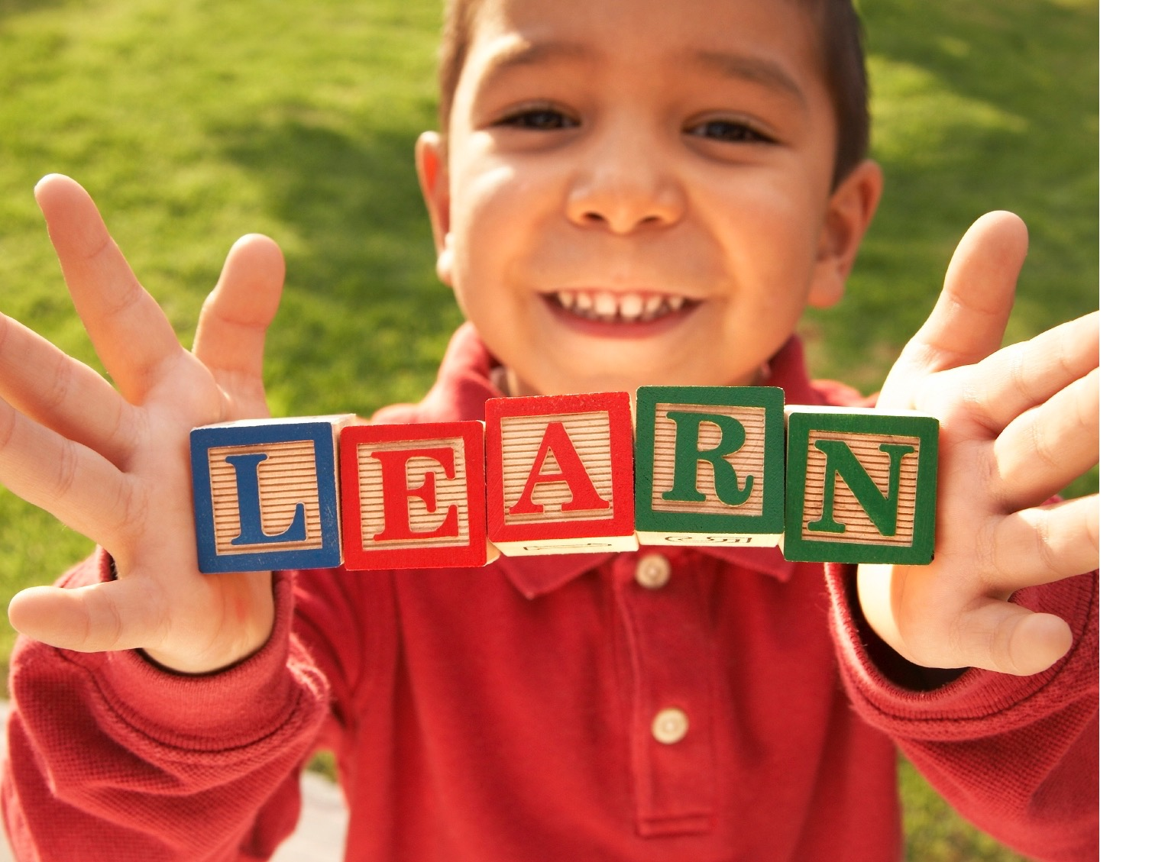
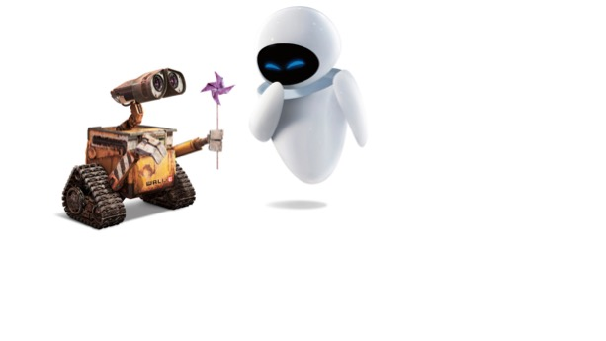
MACHINE
ING

Slide 16
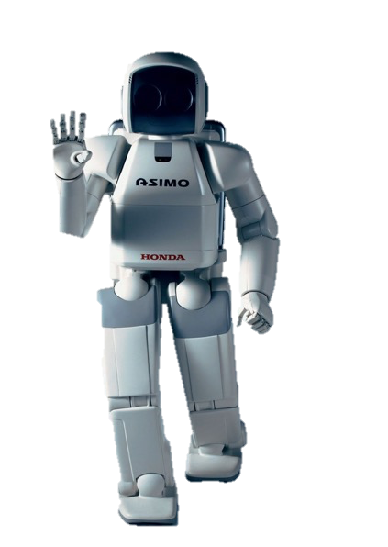
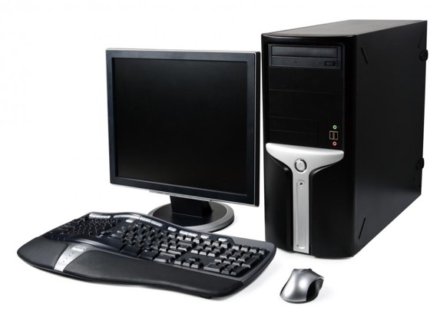
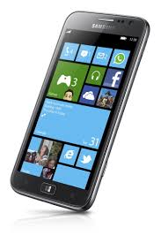
What do computers find difficult?
Notes:
These are all computers – what do they find hard/easy?

Slide 17
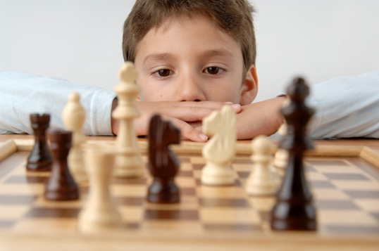
Hard !!!
Pretty tough!
Not very hard!
Pretty easy!

Slide 18
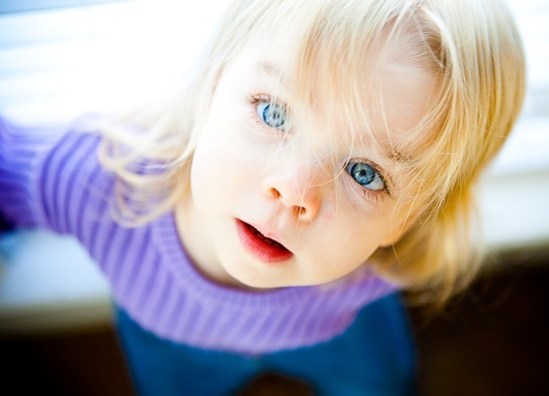
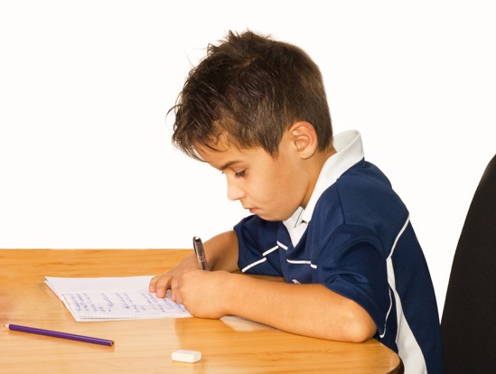
Which needs MOST thought?
Seeing / recognising things
Moving around,
jumping, walking
Learning
Listening / Talking

Slide 19
Where Should I Go?

Slide 20
Eating Out in Townsend
Sophia’s Pizzeria
Cliff’s Cafe
Townsend House
Panda Wok
Townsend Pizza
Bailey’s Bar and Grill

Slide 21
Need THREE Volunteers
I Could just start reading all the reviews…

Slide 22
You Have Two Options

Slide 23
How Does The Reviewer Feel?
Positive: The reviewer feels positively about the restaurant
Negative: The reviewer feels negatively about the restaurant
READY?

Slide 24
Rate These Reviews
R1: "Hometown atmosphere, good food, excellent service"
R2: "Love the selection, BLT with fries and onion rings are delicious"
R3: This is the worst experience I have had one here like the food was gross.
R4: “it was busy, but that is no excuse to serve poor quality food”
R5: "Awesome sushi, food and service great as always!"
R6: Terrible food. Horrible smell to the place. Avoid this place at all costs

Slide 25
After The Tally?
R1: "Hometown atmosphere, good food, excellent service"
R2: "Love the selection, BLT with fries and onion rings are delicious"
R3: This is the worst experience I have had one here like the food was gross.
R4: “it was busy, but that is no excuse to serve poor quality food”
R5: "Awesome sushi, food and service great as always!"
R6: Terrible food. Horrible smell to the place. Avoid this place at all costs

Slide 26
Can We Get a Computer To “Read” The Reviews?

Slide 27
What Is A Computer Program?

Slide 28
Maybe We Can Program Rules?

Slide 29
Which Words Express Sentiment?
R1: "Hometown atmosphere, good food, excellent service"
R2: "Love the selection, BLT with fries and onion rings are delicious"
R5: "Awesome sushi, food and service great as always!"
R3: This is the worst experience I have had one here like the food was gross.
R4: “it was busy, but that is no excuse to serve poor quality food”
R6: Terrible food. Horrible smell to the place. Avoid this place at all costs
Positive Words:
Good
Excellent
Love
Delicious
Awesome
Great
Negative Words:
Worst
Gross
Poor
Terrible
Horrible
Avoid

Slide 30
Rule 1
If the review has a positive word, it’s a positive review, and if it has a negative word, it’s a negative review
Let’s Try It
I heard a lot of horrible stories, but when I went there, the food was not bad.

Slide 31
Rule 2
If the review has a negation word, let’s just flip it.
Let’s Try It
I heard a lot of horrible stories, but when I went there, the food was good.

Slide 32
Rule 3
If the review has both negative and positive words, count them
Let’s Try It
I heard a lot of horrible stories about poor service, but when I went there, the food was good.

Slide 33
You Could Go on for a while..

Slide 34
Let’s Try Some Hard Ones
R1: I live by here and get their food every chance I get. It is not your average greasy Chinese food.
R2: The only draw back to the restaurant is the bar is small, but I'm told they are in the process of expanding it.
R3: The pizza looked great and probably would have even tasted fine if not for the fact it was permeated with the smell (and taste) of gas.
R4: Salads might come without dressing & you might have to wait 7 minutes for it.
R5: The brownies are gooey and chewy
R6: The Crab Rangoons are chewy, not crispy

Slide 35
Imagine Writing All These Rules

Slide 36
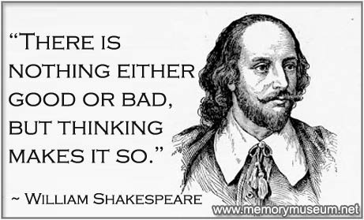
Also, Human Language Is Tricky

Slide 37
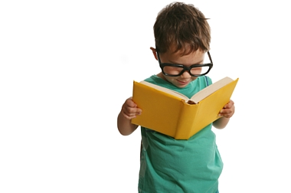
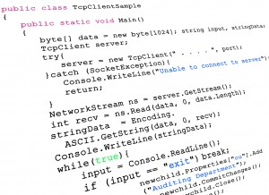
Learn by examples!
Write computer Code
Notes:
We write CODE from what Psy does.

Slide 38
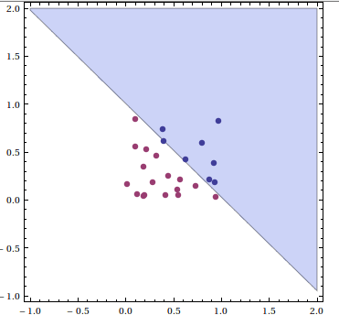
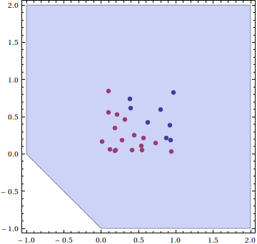
Machine
Learning
Examples of what we want it to do
☺
Mathematical model
Human
“supervisor”
helps correct it
Finished model for task

Slide 39
Yelp Reviews

Slide 40
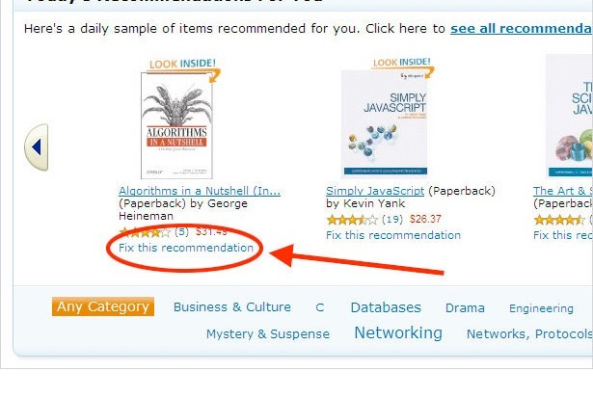
You’re the supervisor!

Slide 42
Imagine How Much a computer can learn if IT can learn to “read”?

Slide 43
AND LEARN TO “LISTEN”,“TALK”, “SEE”, “REASON”, “THINK”, “EXPRESS”….

Slide 44
Will you help build it?
We’re almost living in that world

Slide 45
Acknowledgements
Thanks to my awesome AI researcher friends for their suggestions
Thanks to Prof. Gavin Brown at University of Manchester for many of his slides.
He also has a great talk about Artificial Intelligence on YouTube.
https://www.youtube.com/watch?v=Q43XtgxS7YA

Slide 46
THE END

